Slide 1
Inventory control system
A GUI based application for managing inventory

Slide 2
Problem statements
Manual inventory management can be time consuming, prone to errors and inefficiency.This system aims to automate and stream inventory managements processe
Reduce manual errors
Increase efficiency
Improve inventory tracking and management

Slide 3
System review
The inventory management system is a GUI based application built using python and SQLITE. It allows users to manage inventory, track stock levels and perform crud operations.
User authentication and authorization
Inventory management(crud operations)
Stock level tracking and alerts

Slide 4
features
User friendly GUI
Inventory management(add,update,delete,view)
Stock level tracking and alerts
Order management(place orders, update stock levels)
Restocking management(add stock,updatestock levels)

Slide 5
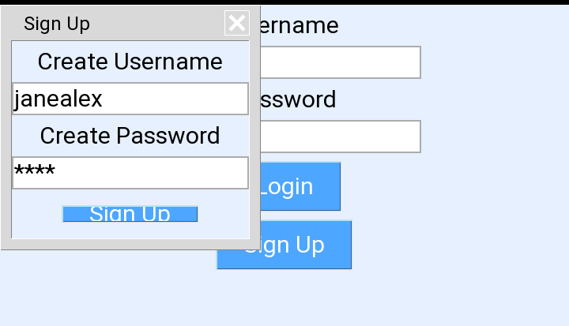
Database design
The system uses a SQLITE database to store user and inventory data

Slide 6
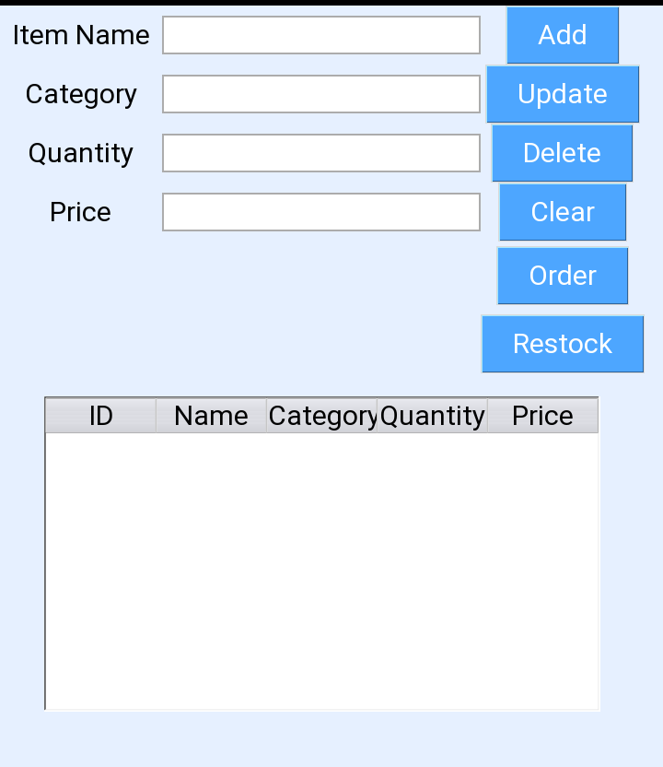
Database design
The system uses a SQLITE database to store user and inventory data

Slide 7
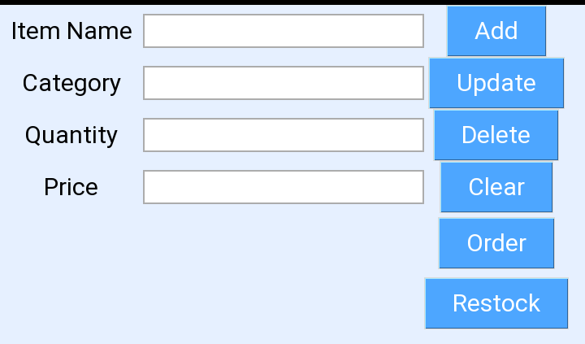
User interface
The system has an intuitive and user friendly interface that makes it easy to manage inventory and perform crud operations

Slide 8
User interface
The system has an intuitive and user friendly interface that makes it easy to manage inventory and perform crud operations

Slide 9
benefits
Improved efficiency
Reduced manual errors
Better inventory tracking and management
Enhanced user experience

Slide 10
conclusion
The inventory management system is a powerful tool for managing inventory and streamlining business processes. Its user friendly interface and robust (GUI)features make it an ideal solution for business of all sizes.

Slide 11
FUTURE ENHANCEMENTS
Integration with other business systems(e.g., accounting, sales)
Advanced reporting and analytics
Mobile app application
Enhanced security features
end

